Slide 1
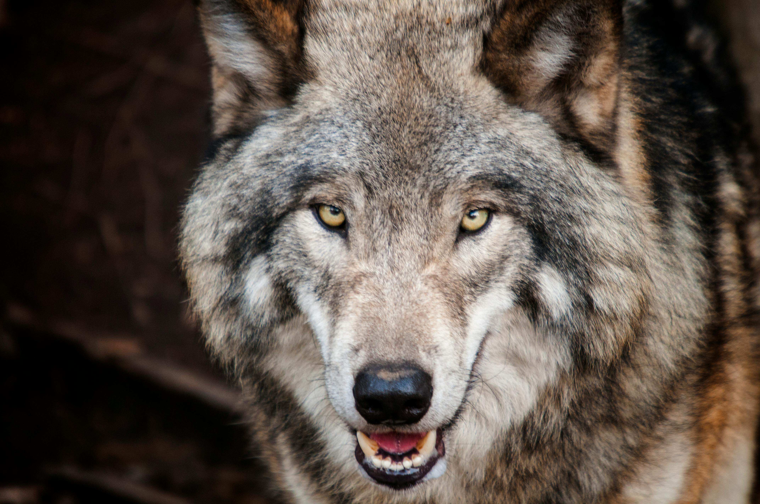
The Maths of Predators and Preys Don’t get Eaten by the Wolf
Dr John Butler TU Dublin (Lecturer in Mathematics and Statistics)

Slide 2
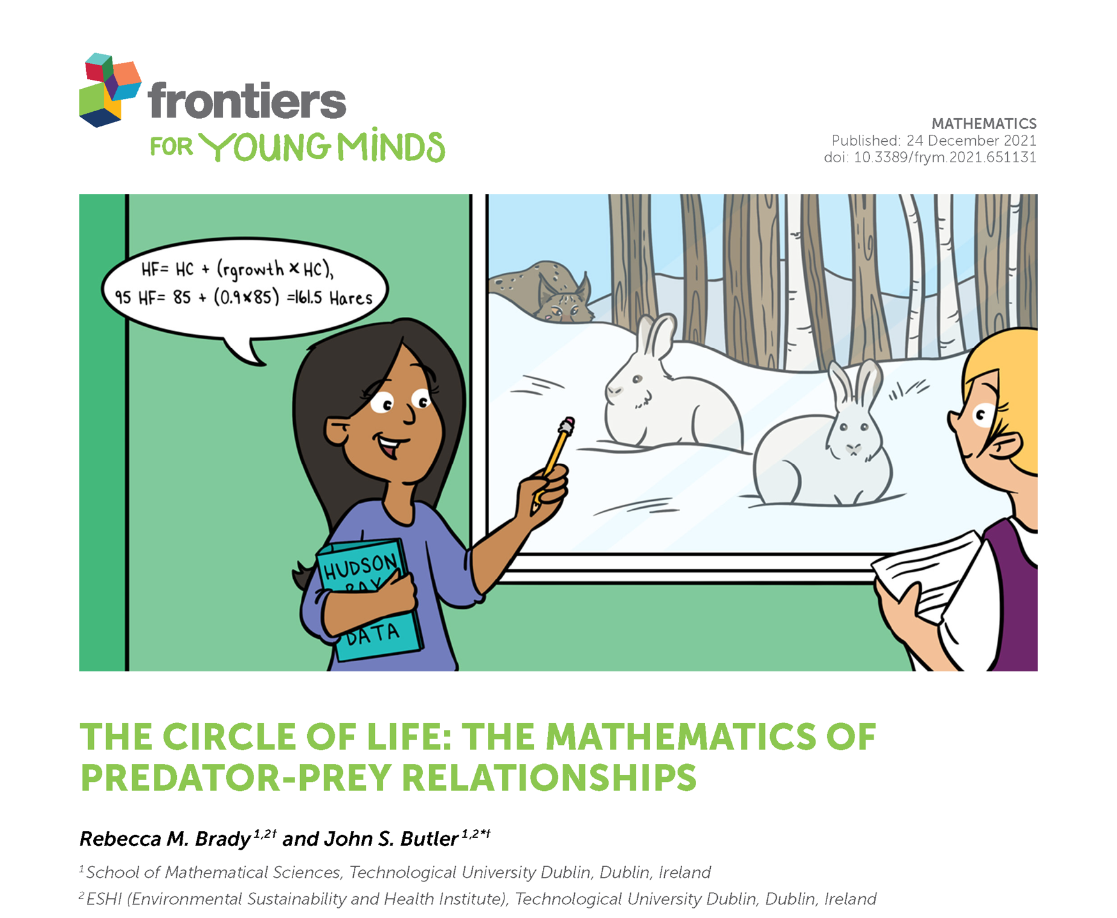

Slide 3
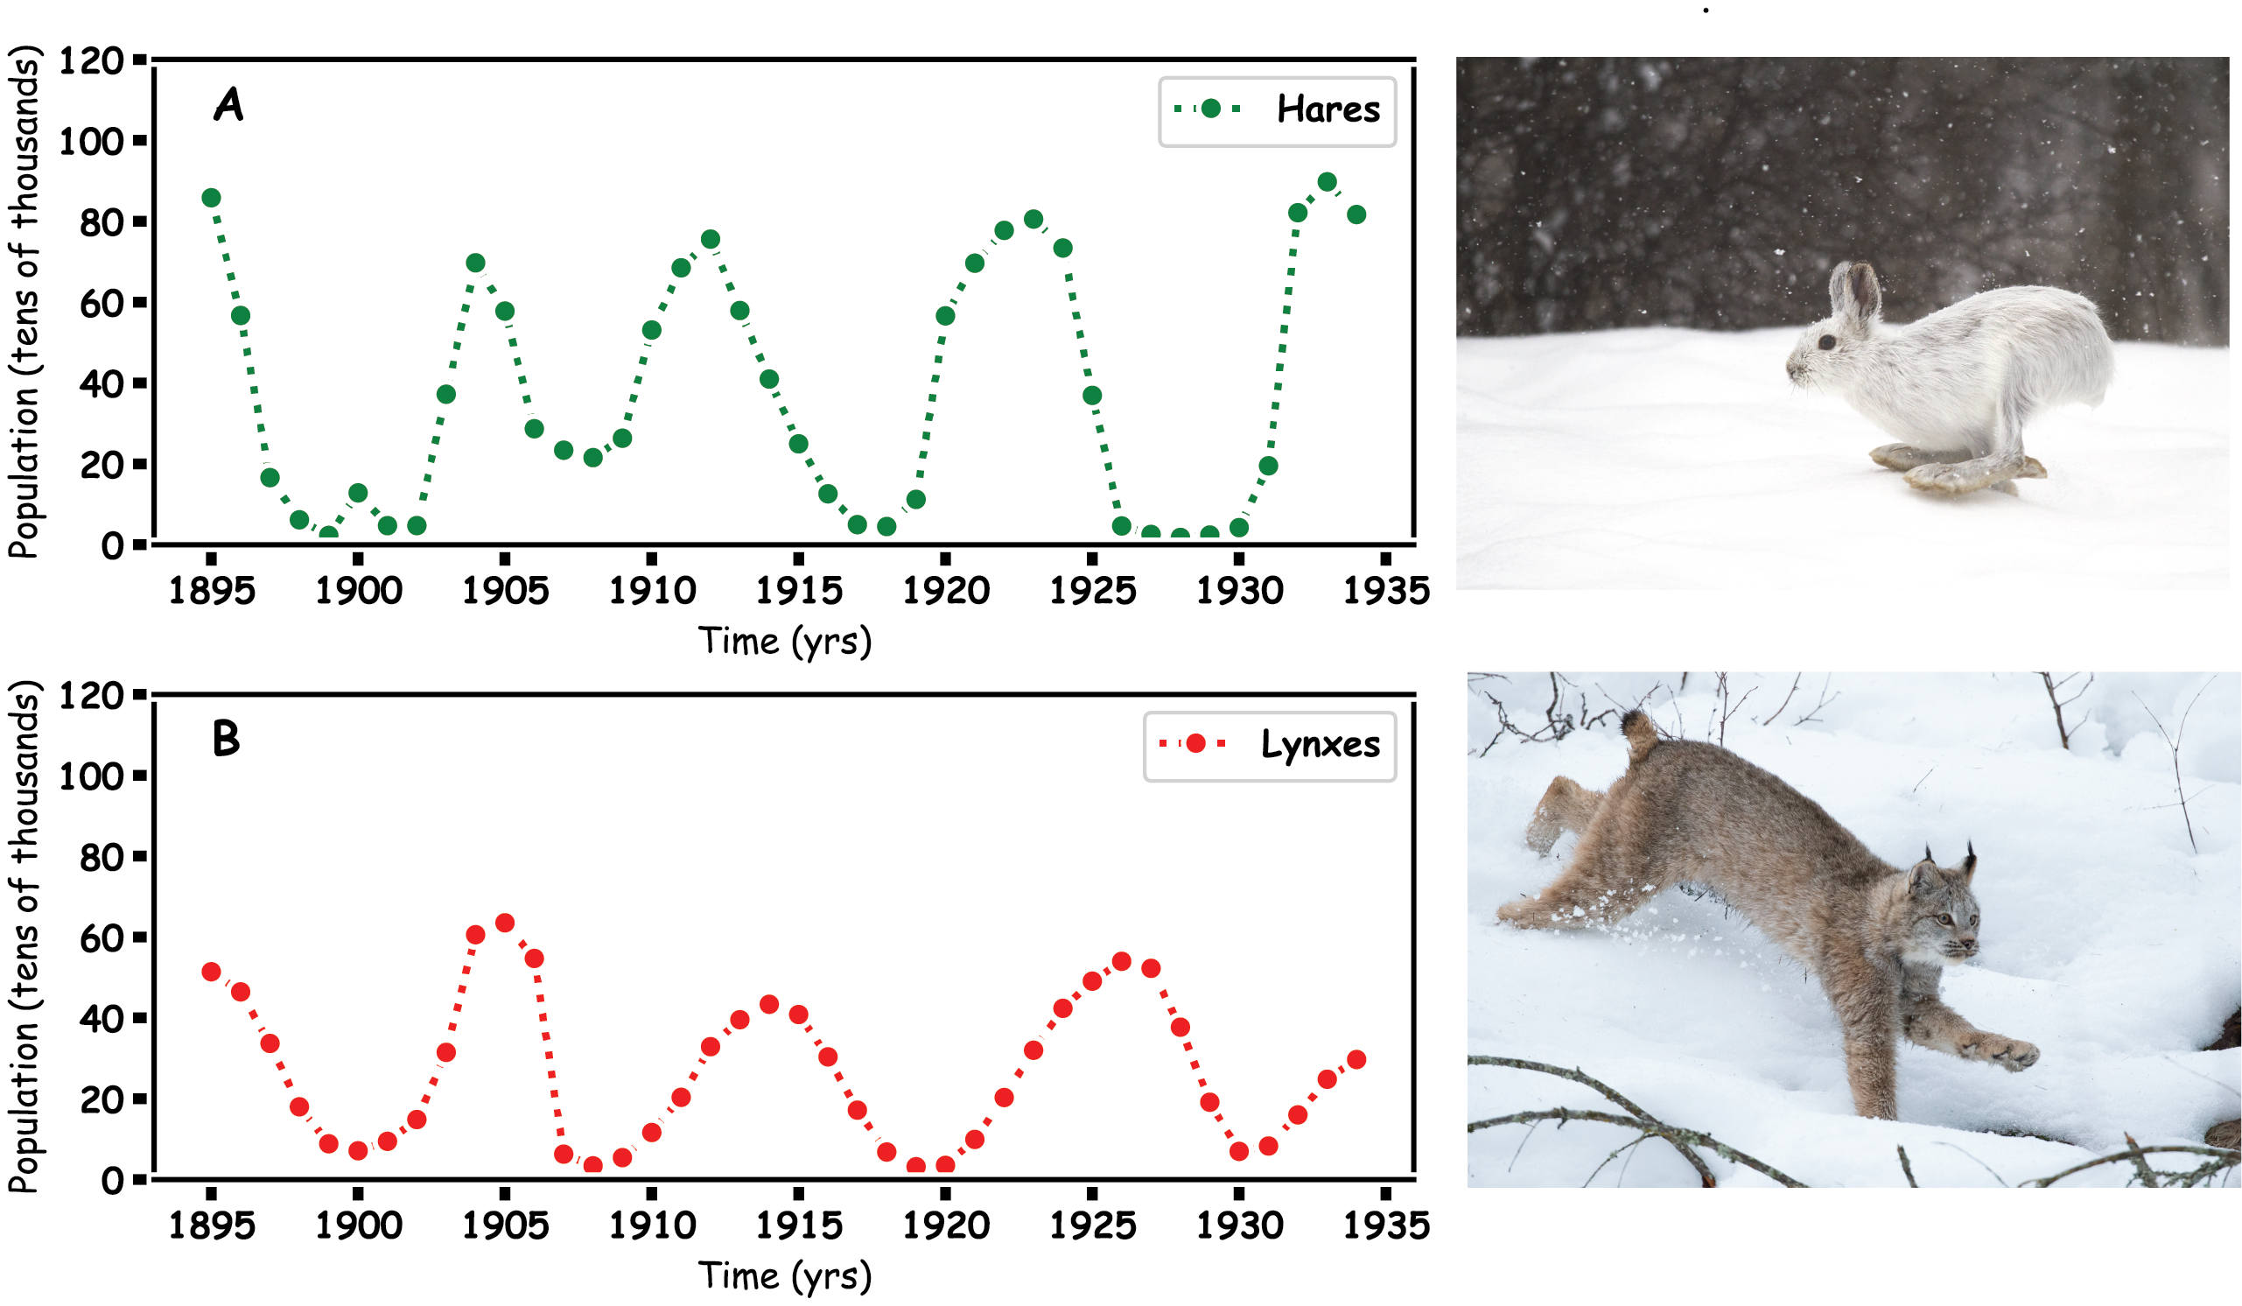
Predator Prey
Hares and Lynx

Slide 4
Prey Hares

Slide 5
Predator

Slide 6
Predator and Prey

Slide 7
Mathematics

Slide 8
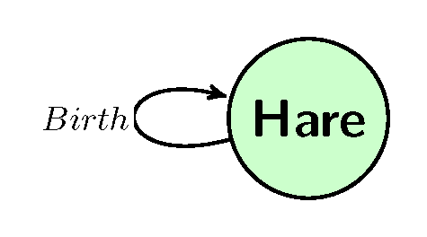

Hares
How to we make a model for a Hare population

Slide 9
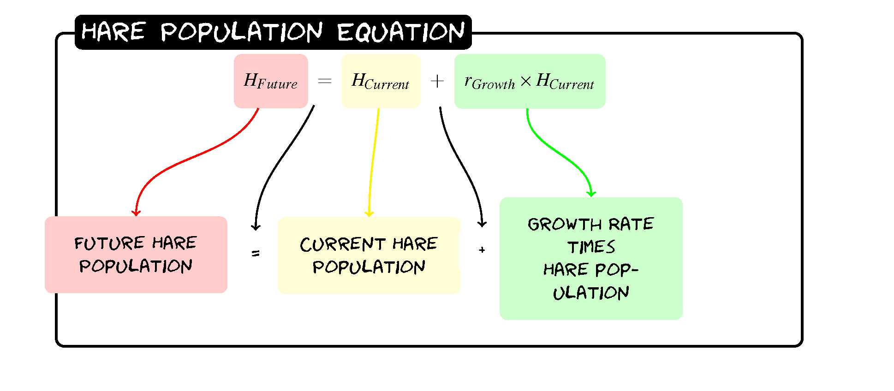
Hares

Slide 10
Hares
Year | Hare Population
0 | 60
1
2
3

Slide 11
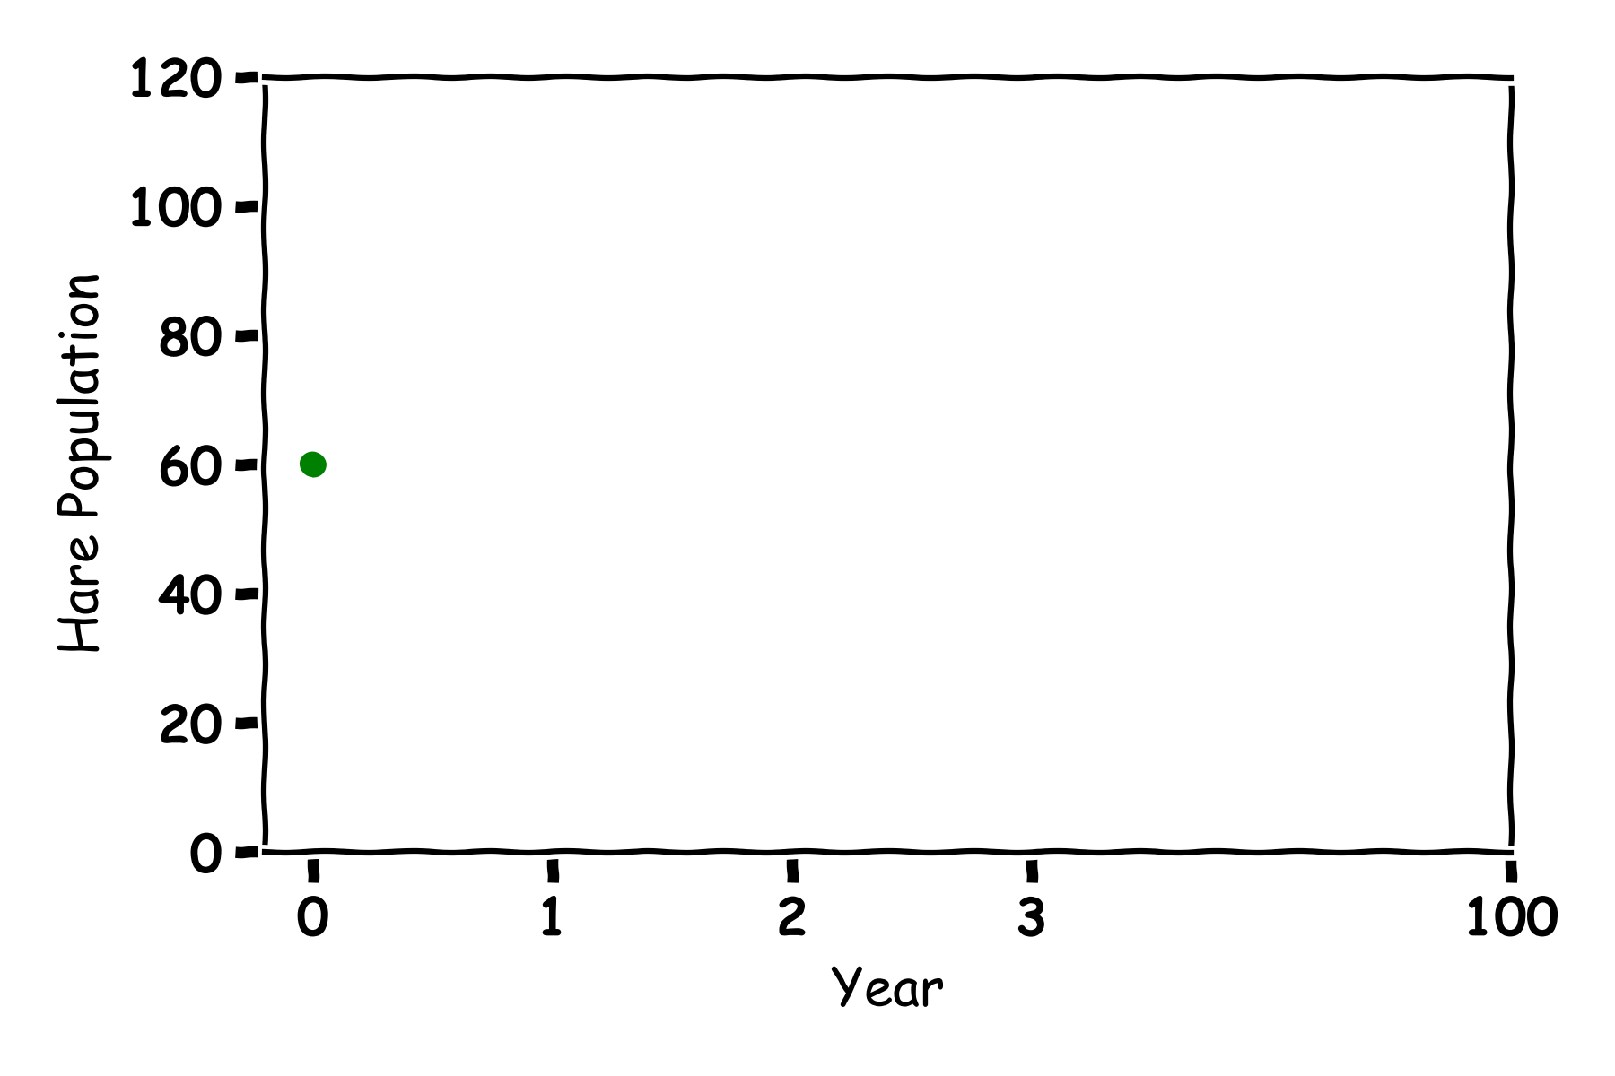
Hares
Year | Hare Population
0 | 60
1 | 60+0.2(60)=72
2
3

Slide 12
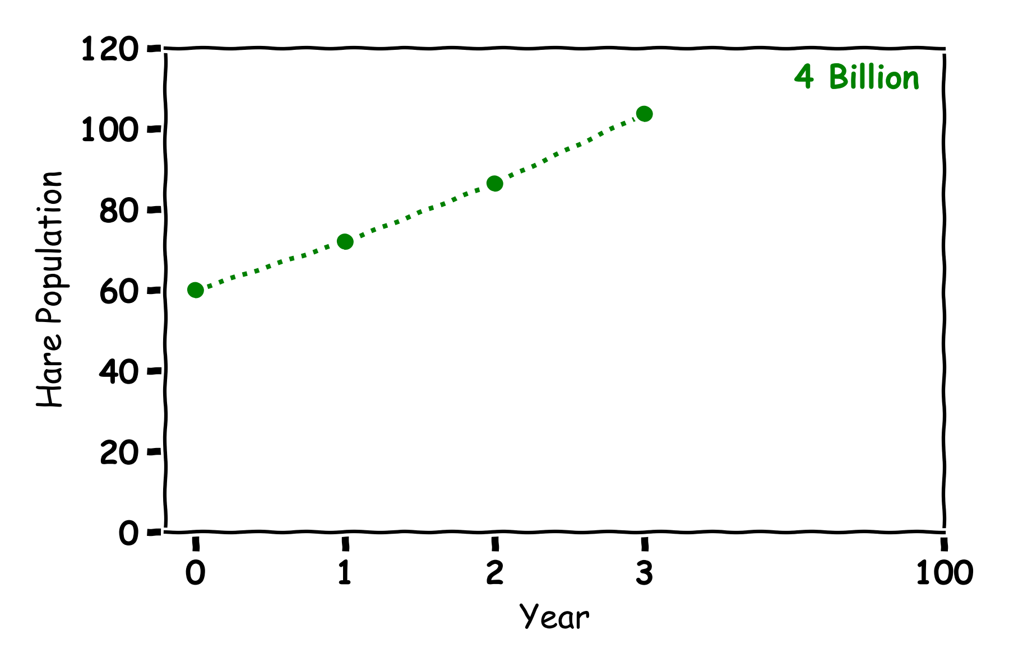
Hares
Year | Hare Population
0 | 60
1 | 72
2 | 86
3 | 103

Slide 13
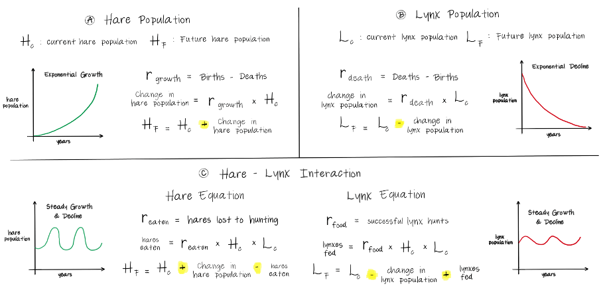
Hare Population

Slide 14
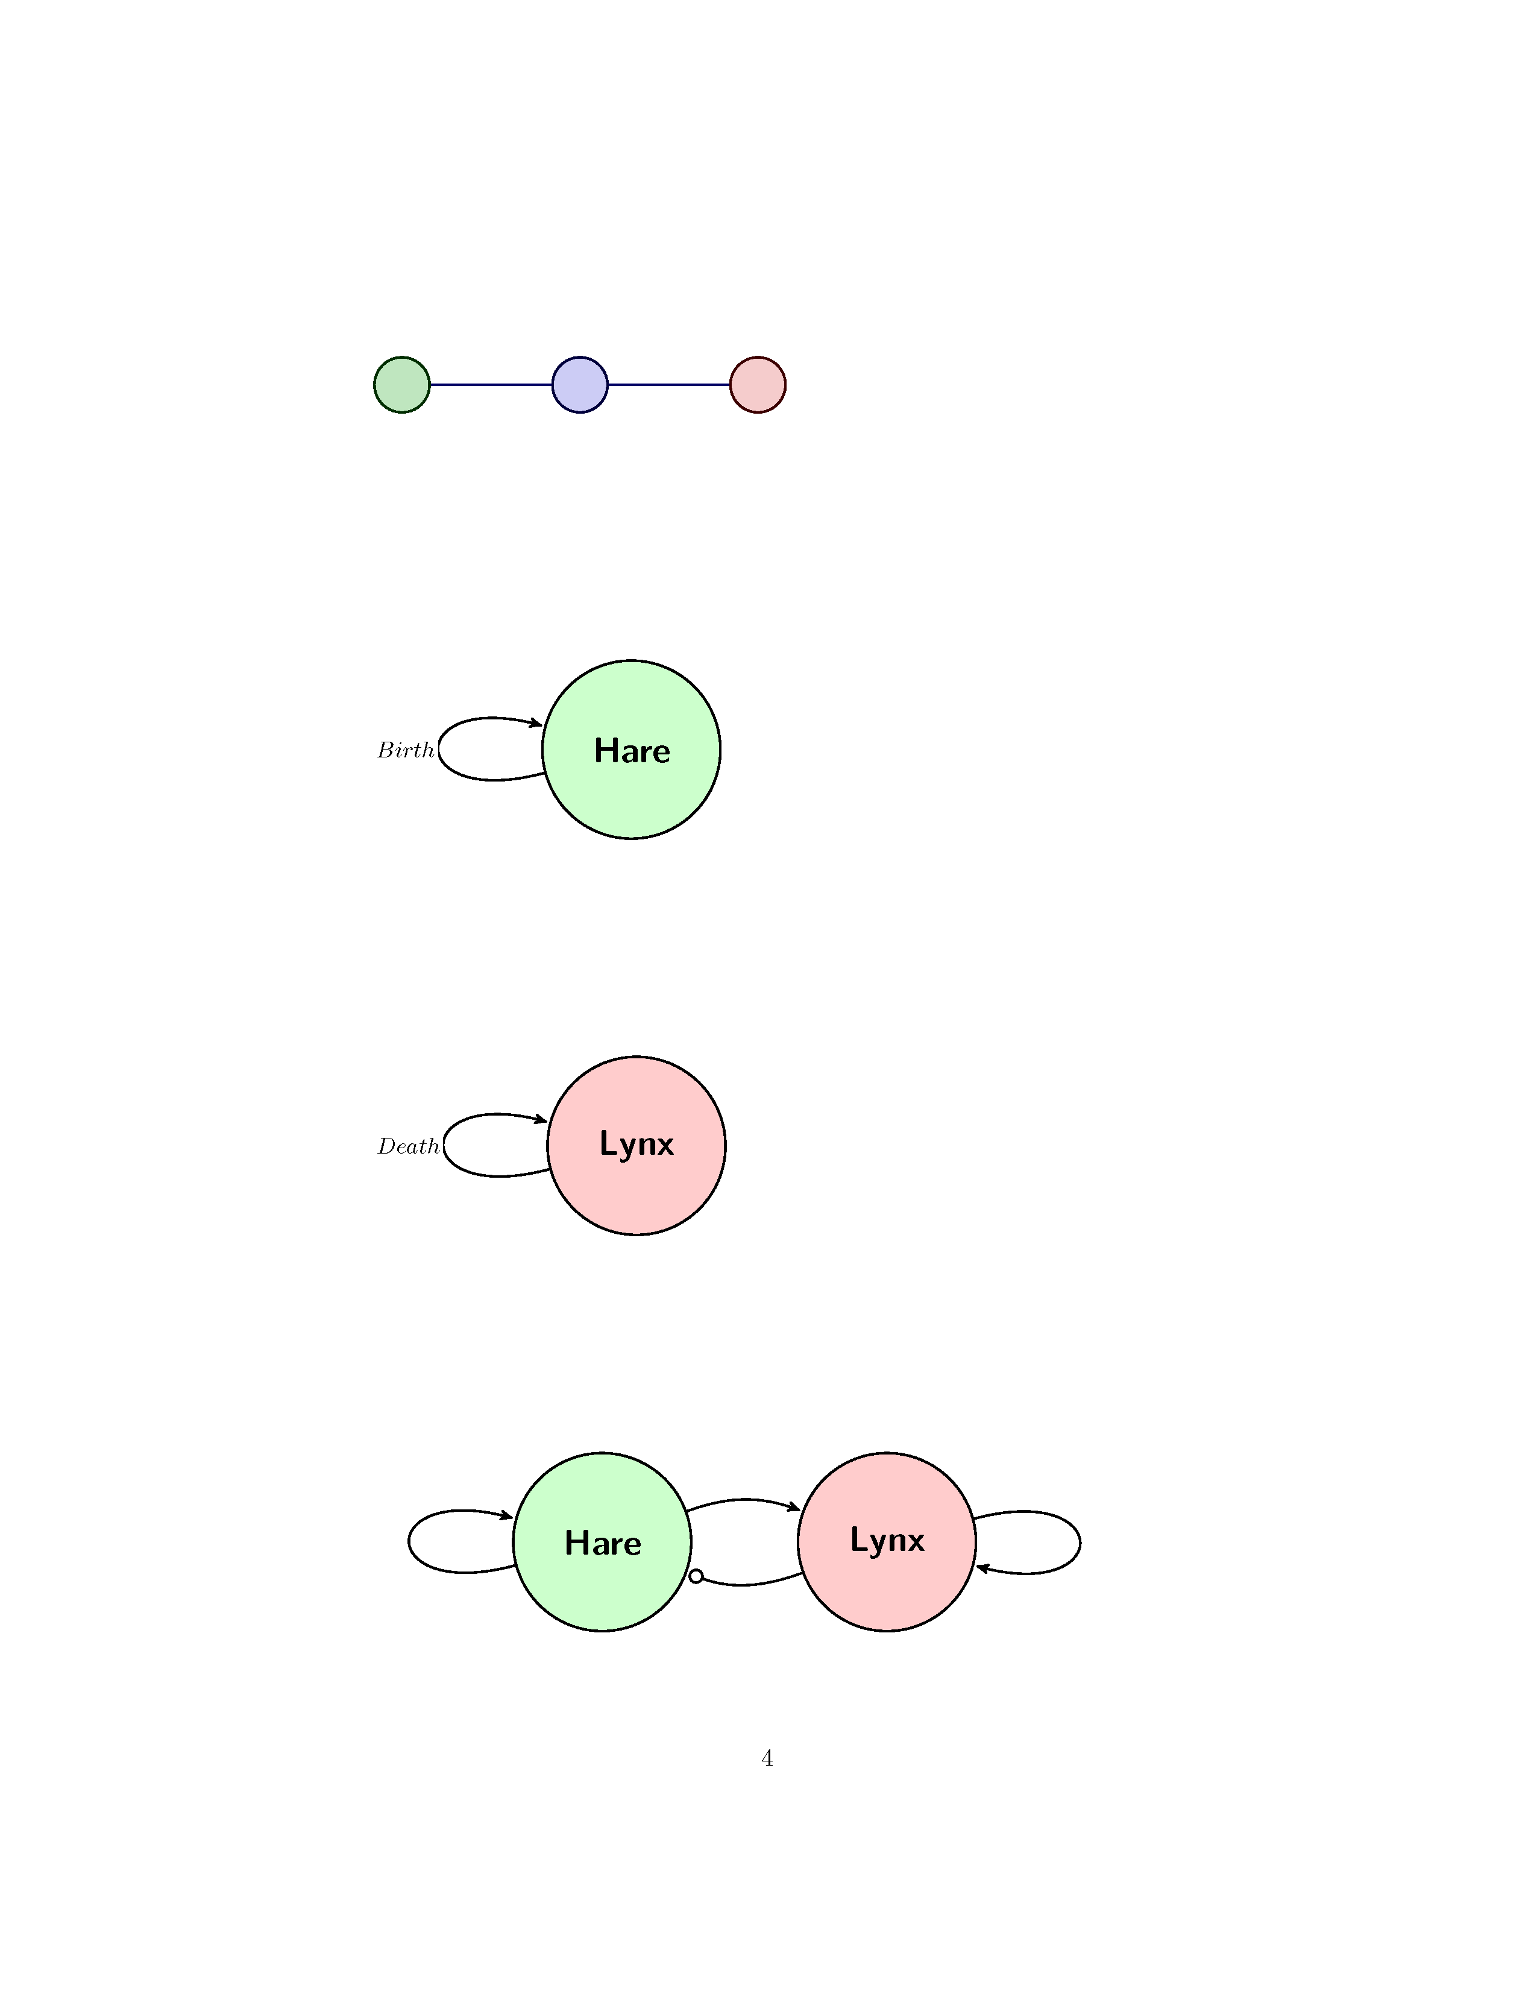
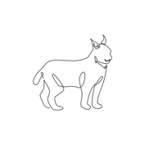
Lynx
How to we make a model for a Lynx population

Slide 15

Lynx

Slide 16
Lynx
Year | Lynx Population
0 | 30
1
2
3

Slide 17
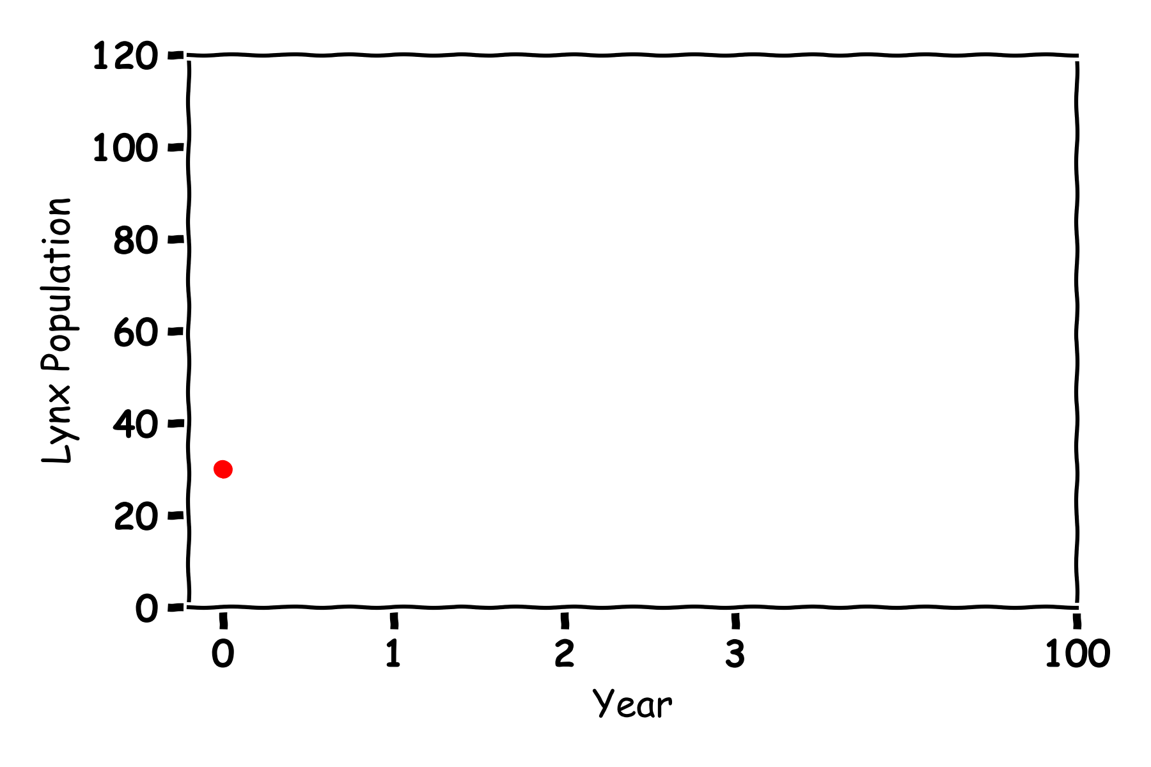
Lynx
Year | Lynx Population
0 | 30
1
2
3

Slide 18
Lynx
Year | Lynx Population
0 | 30
1 | 30-0.1*30=27
2
3

Slide 19
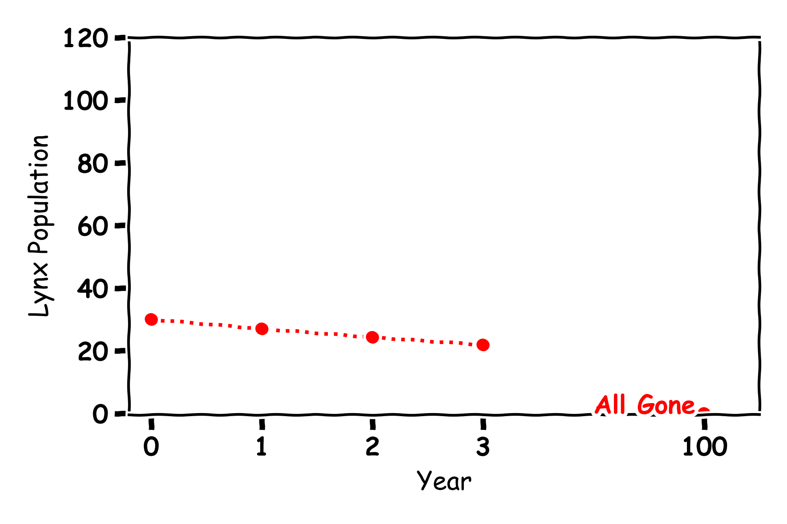
Lynx
Year | Lynx Population
0 | 30
1 | 27
2 | 24
3 | 22

Slide 20
Lynx

Slide 21
Predator and Prey

Slide 22
Predator and Prey

Slide 23
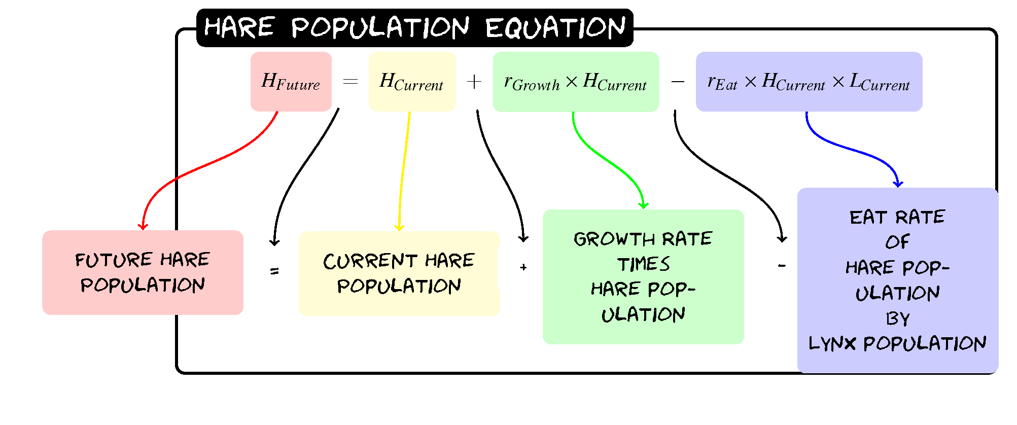
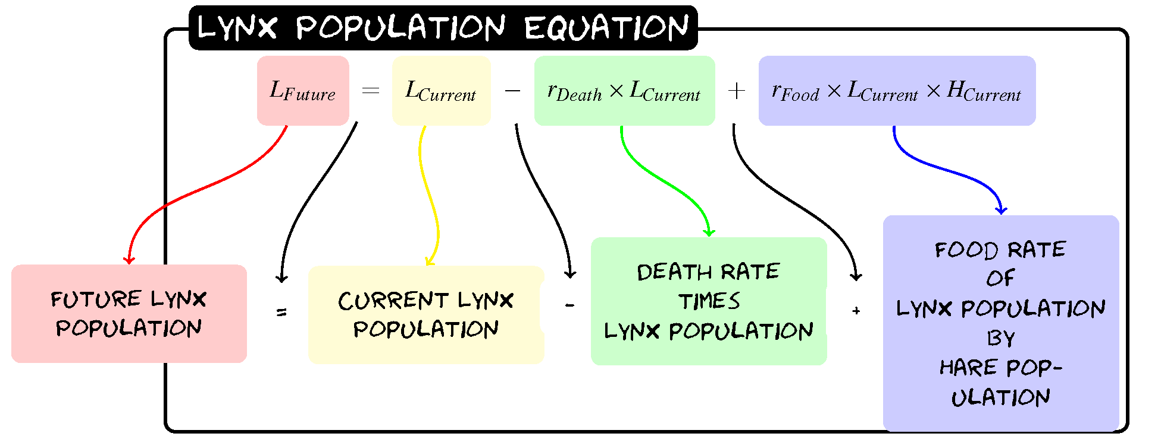
Predator and Prey

Slide 24
Predator and Prey
H_{Future}=H+0.2(H)-0.005(H)(L)
L_{Future}= L-0.1(L)+0.002(L)(H)

Slide 25
Predator and Prey
H_{Future}=H+0.2(H)-0.005(H)(L)
L_{Future}= L-0.1(L)+0.002(L)(H)
Year | Hare Population | Lynx Population
0 | 60 | 30
1
2
3

Slide 26
Predator and Prey
H_{Future}=H+0.2(H)-0.005(H)(L)
L_{Future}= L-0.1(L)+0.002(L)(H)
Year | Hare Population | Lynx Population
0 | 60 | 30
1 | 60+0.2(60)-0.005(60)(30)=63 | 30-0.1(30)+0.002(30)(60)=30.6
2 | 63+0.2(63)-0.005(63)(30.6)=65.9 | 30.6-0.1(30.6)+0.002(30.6)(63)=31.3
3 | 65.9+0.2(65.9)-0.005(65.9)(31.3)=68.8 | 31.3-0.1(31.3)+0.002(31.3)(65.9)=32.4

Slide 27
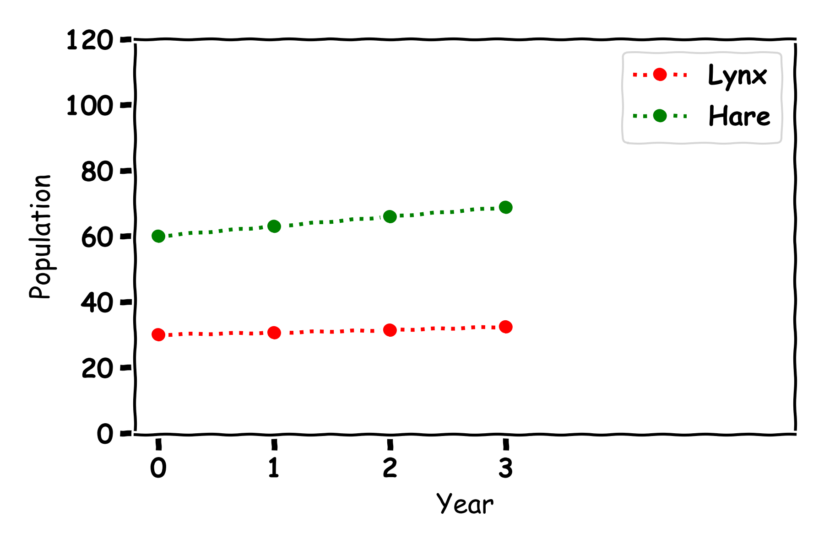
Predator and Prey
Year | Hare Population | Lynx Population
0 | 60 | 30
1 | 63 | 30.6
2 | 65.9 | 31.3
3 | 68.8 | 32.4

Slide 28
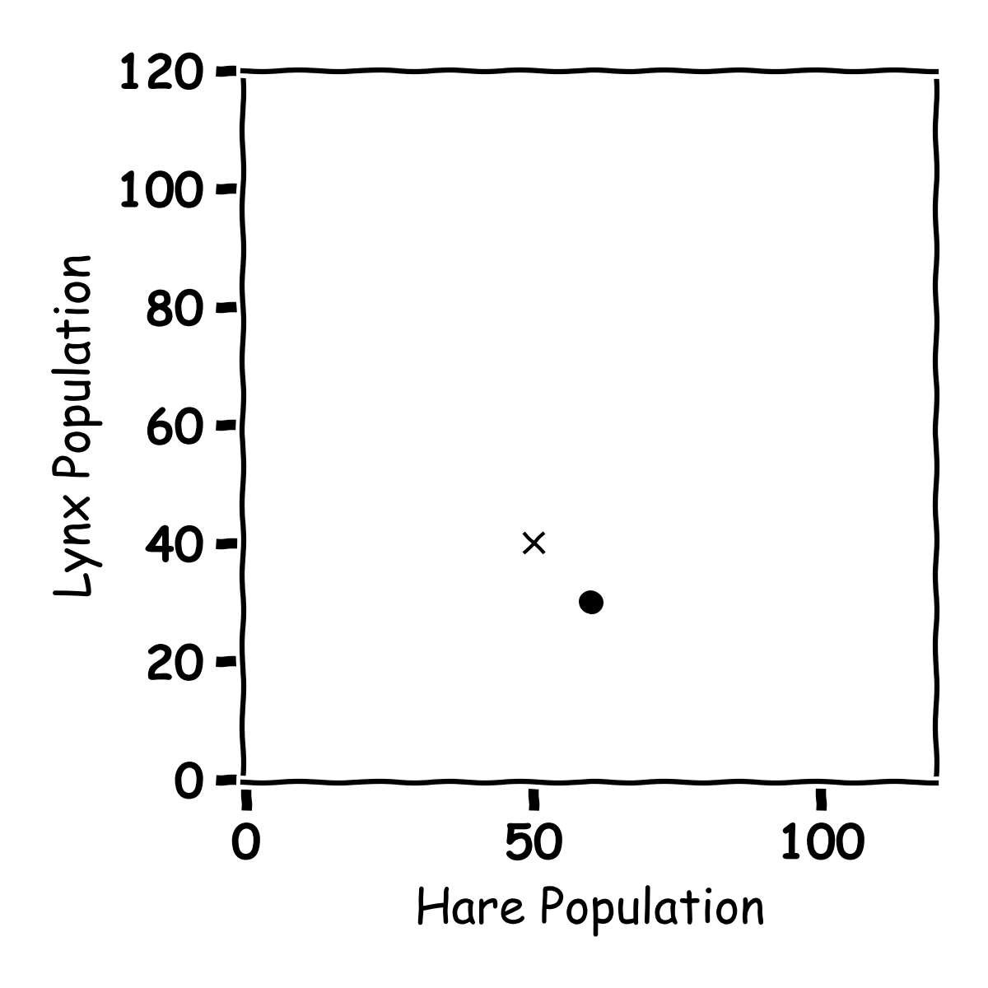
Predator and Prey
Year | Hare Population | Lynx Population
0 | 60 | 30
1
2
3

Slide 29
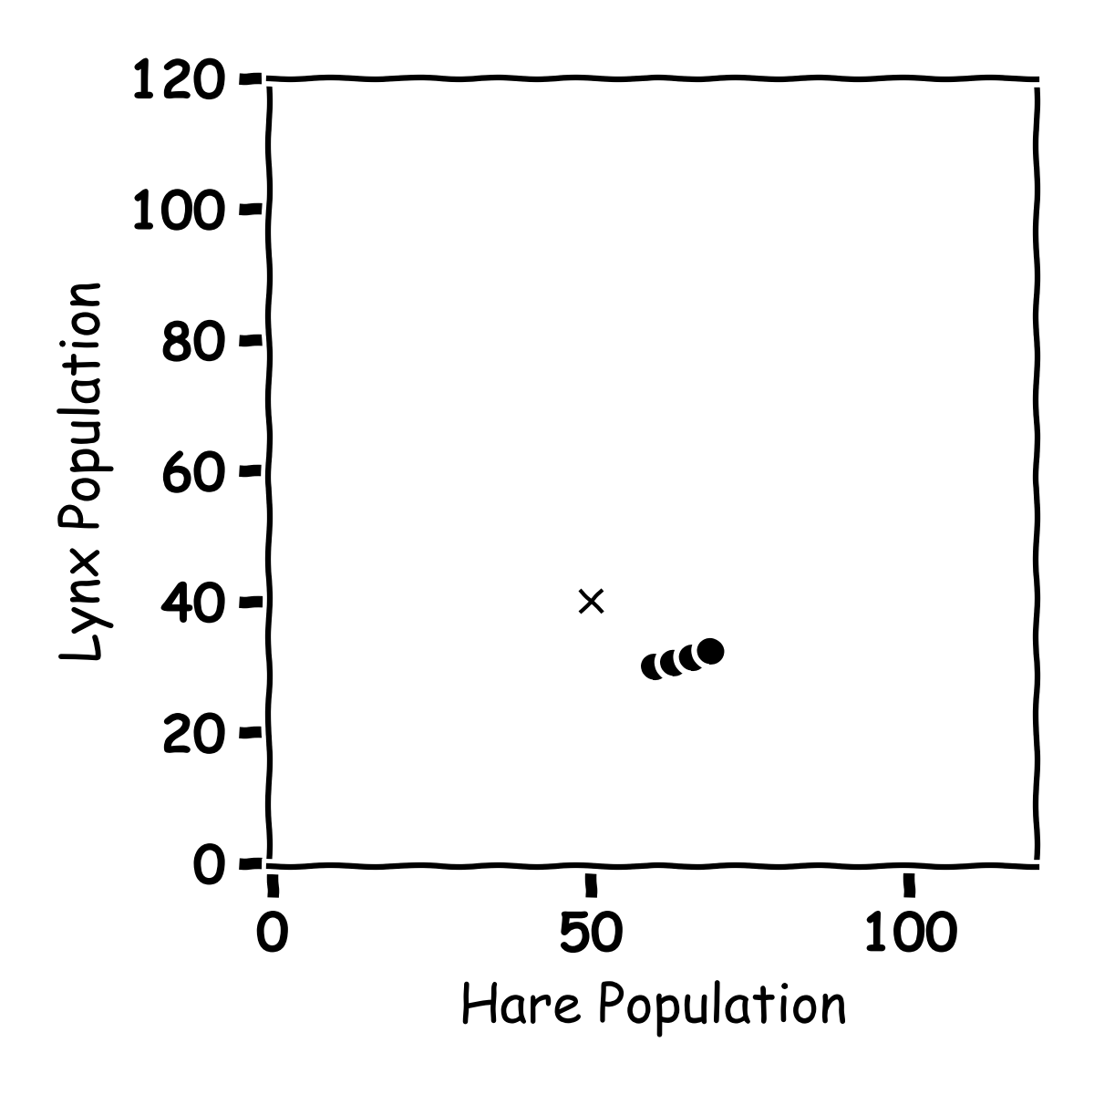
Predator and Prey
Year | Hare Population | Lynx Population
0 | 60 | 30
1 | 63 | 30.6
2 | 65.9 | 31.3
3 | 68.8 | 32.4

Slide 30
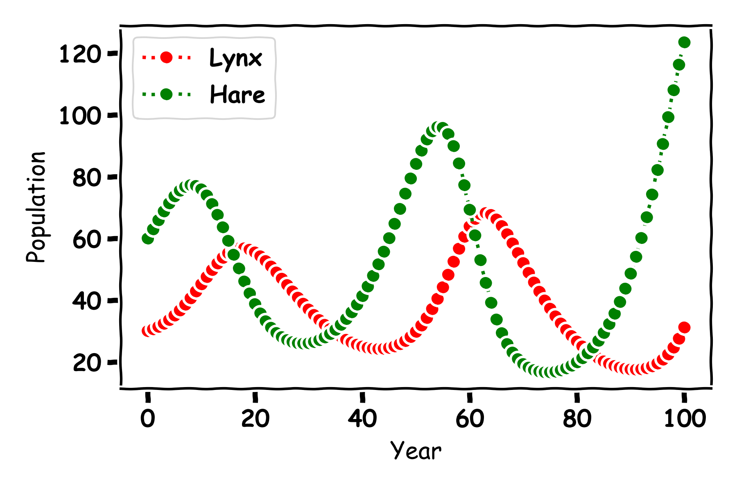
Predator and Prey

Slide 31
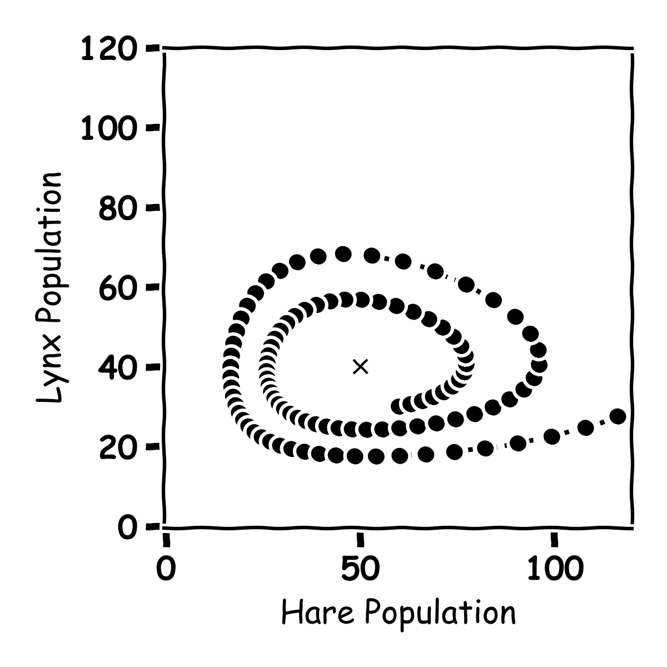
Predator and Prey

Slide 32
Predator and Prey

Slide 33
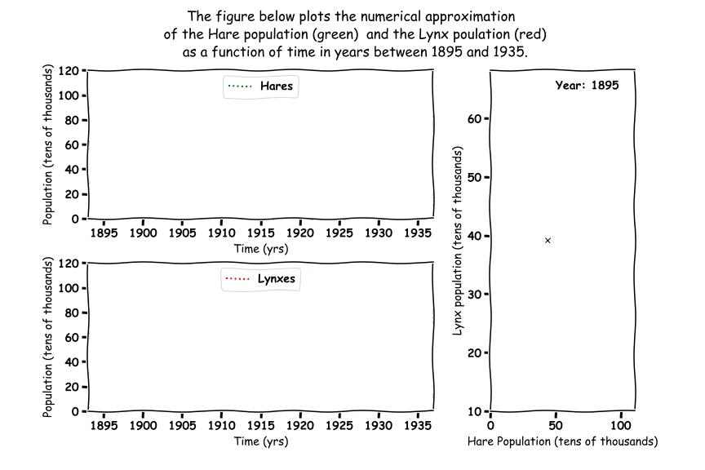
Predator and Prey

Slide 34
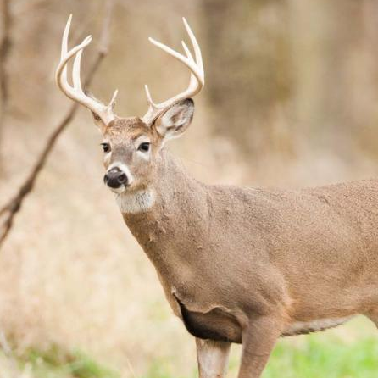
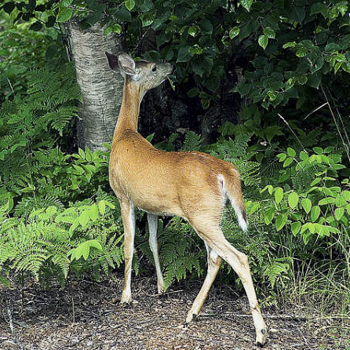
Predator Prey
Deer, Plants and Wolves

Slide 35
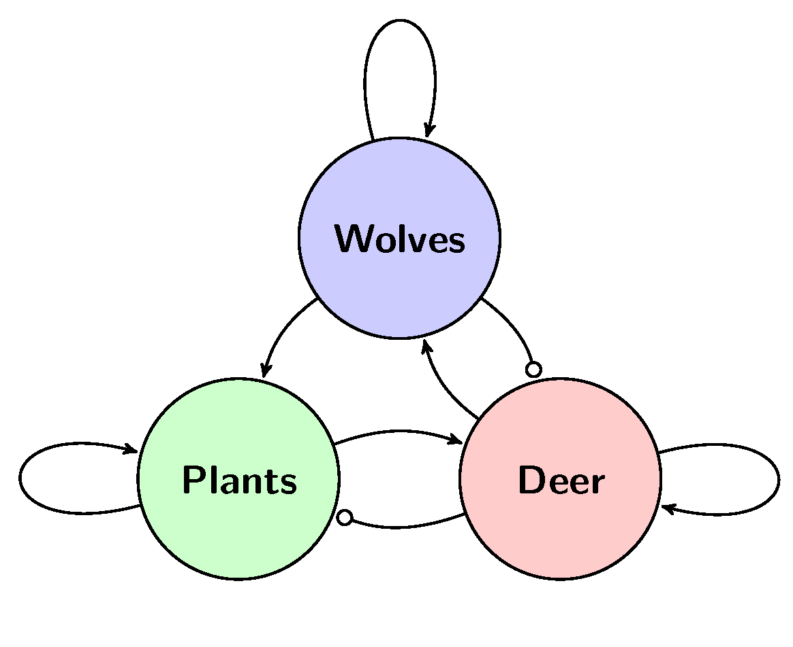
Three Animals

Slide 36
Three Animals
Death rate Wolves
Wolves project plants
Wolves eat Deer
Food for wolves
Food for Deer
More Plants Grow
More Deer Born
Deer eat plants

Slide 37
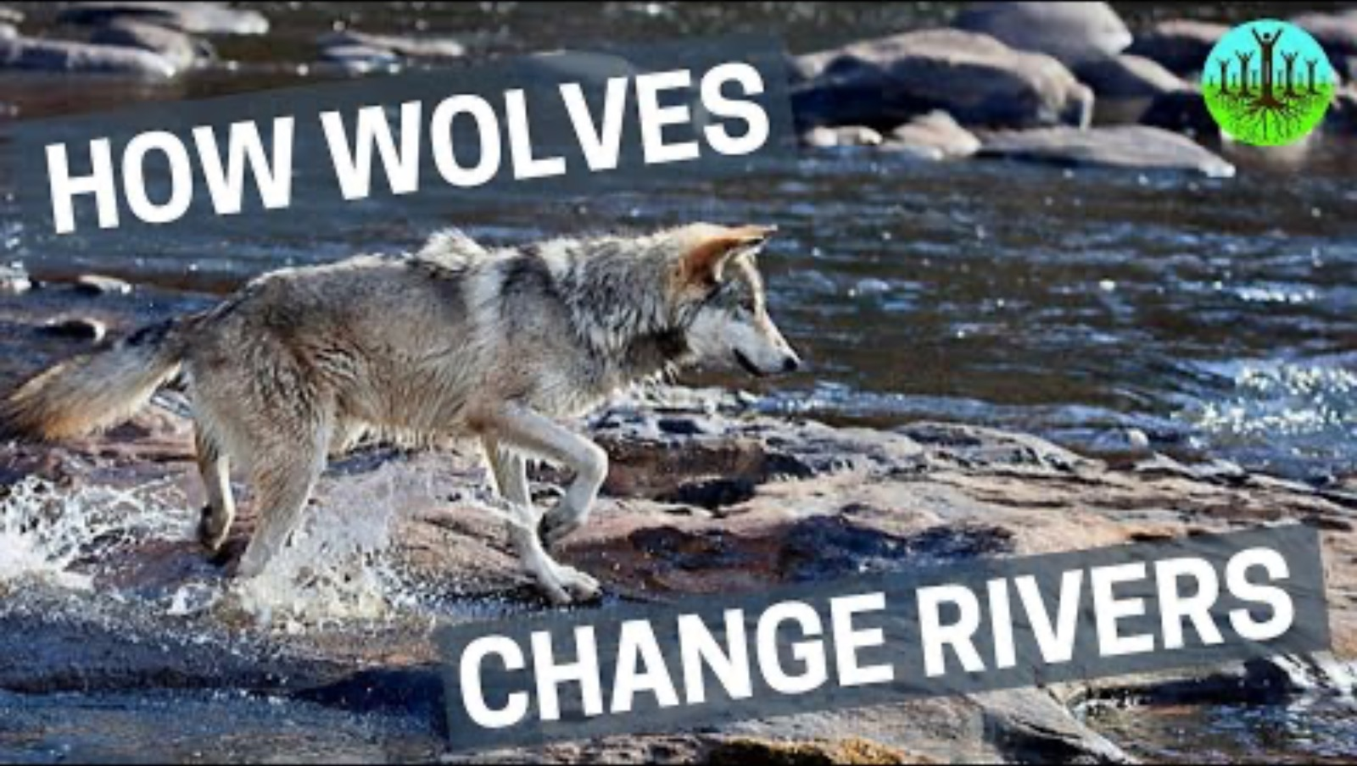
Three Animals

Slide 38
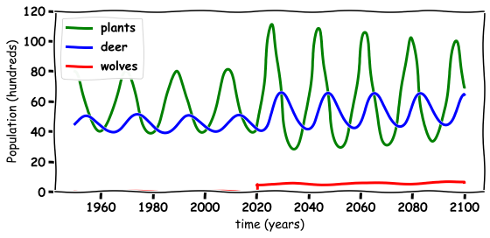
Three Animals

Slide 39
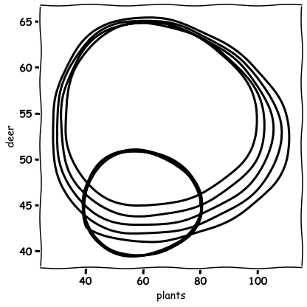
Three Animals

Slide 40

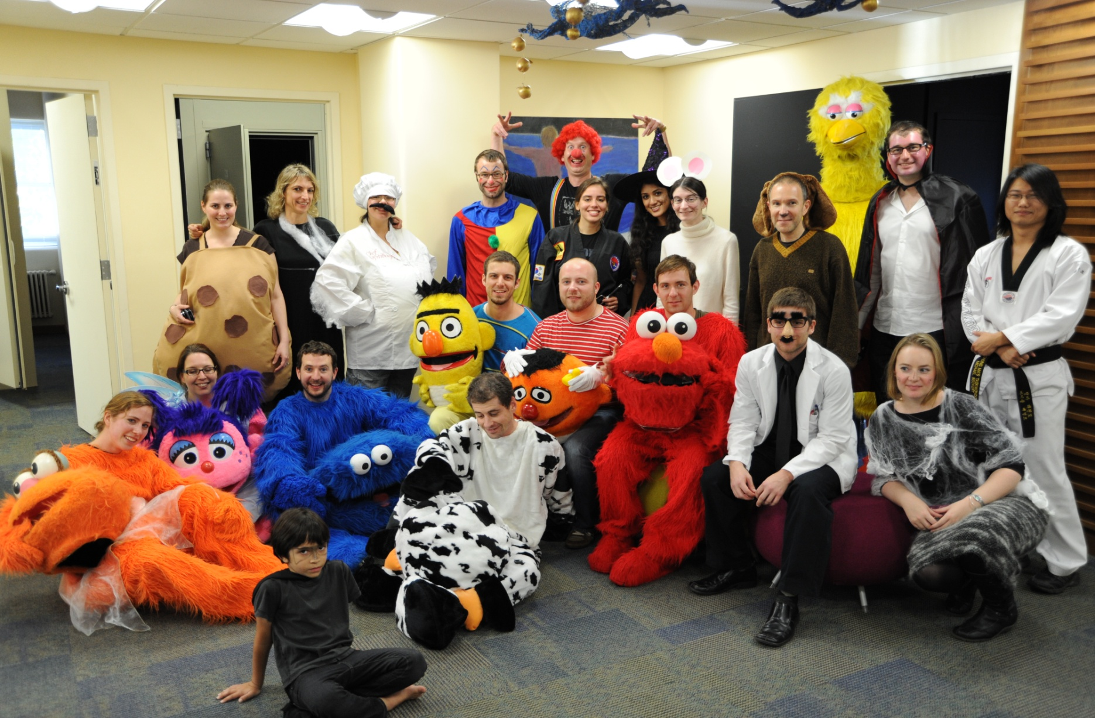

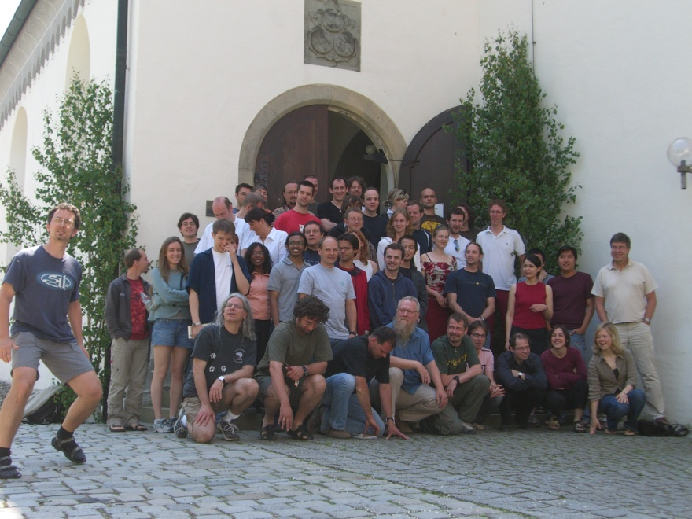
Thank you for Listening
TCD
Albert Einstein College of Medicine
TU Dublin
Max Planck Institute Germany

